Slide 1
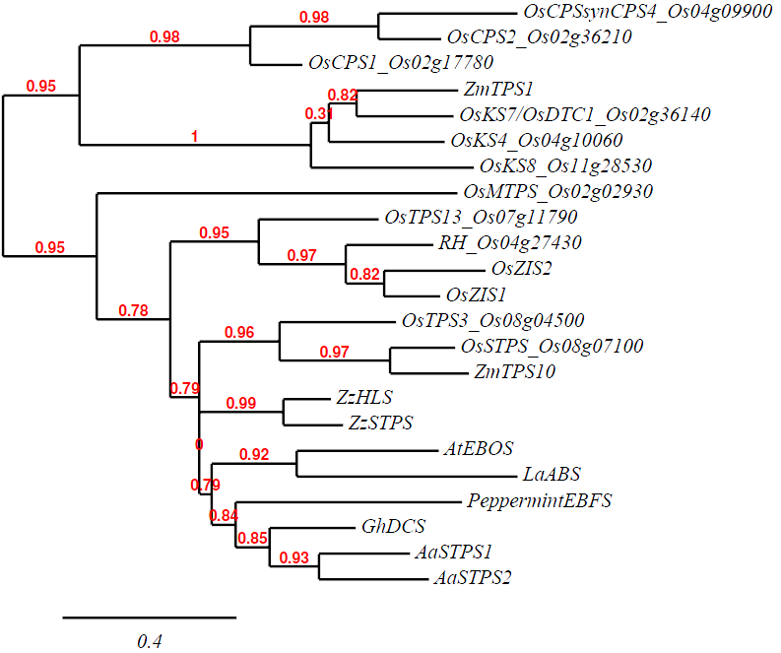
Figure 6.
Diterpene synthase
Monoterpene synthase
Sesquiterpene synthase

